Slide 1
Predicting Lead Conversion: Enhancing Sales Prioritization with Machine Learning
Utilizing data for better sales decision-making
Notes:
AI-generated content may be incorrect. --- This presentation explores the use of machine learning to predict lead conversion likelihood, thus enhancing sales prioritization. We aim to leverage data-driven insights to optimize sales strategies and improve overall conversion rates.

Slide 2
Agenda Items
Problem Statement and Objective
Analysis Approach
Results in Business Terms
Visualizations
Summary of Results
Notes:
We will begin with the problem statement and objectives regarding lead conversion prediction. Next, we will outline our analysis approach, including data cleaning and model building. We will then share the results in business terms, discuss visualizations, and culminate with a summary of key findings.

Slide 3
Problem Statement and Objective
Notes:
Understanding the lead conversion process is critical for sales success. Our aim is to predict which leads are likely to convert and to optimize our sales efforts accordingly.

Slide 4

Problem Statement: Predicting Lead Conversion Likelihood
Lead Conversion Challenge
Accurately predicting lead conversion likelihood is crucial for optimizing sales strategies and improving conversion rates.
Prioritizing Sales Efforts
Understanding which leads are most likely to convert helps in effectively prioritizing sales efforts and resource allocation.
Resource Allocation
Effective resource allocation is essential in maximizing the return on investment in sales activities and lead management.
Notes:
The challenge lies in accurately predicting which leads are most likely to convert into customers. This insight is essential for prioritizing sales efforts and resources effectively.

Slide 5

Objective 1: Cleaning and Preparing Data for Analysis
Handling Missing Values
Properly addressing missing values is crucial to ensure accurate analysis and insights from the dataset.
Removing Irrelevant Features
Identifying and removing irrelevant features is essential to enhance the quality of data and focus on important variables.
Data Suitability
Ensuring data is suitable for analysis involves transforming and normalizing data to meet analytical requirements.
Notes:
The first objective is to clean and prepare the data, which involves handling missing values, irrelevant features, and ensuring the data is suitable for analysis.

Slide 6
Objective 2: Building, Tuning, and Evaluating Machine Learning Models
Model Building
Building machine learning models involves selecting the right algorithms and preparing the dataset for training.
Model Tuning
Tuning models is crucial to optimizing performance, which can be achieved through techniques like hyperparameter adjustment.
Model Evaluation
Evaluating models helps in understanding their effectiveness in predicting lead conversions and involves metrics like accuracy and precision.
Notes:
Our second objective is to build, tune, and evaluate various machine learning models to determine the best approach for predicting lead conversions.

Slide 7

Objective 3: Providing Actionable Insights
Actionable Insights
Our analysis aims to deliver actionable insights that drive effective decision-making within sales teams.
Focus on High-Value Leads
By identifying leads with the highest likelihood of conversion, sales teams can optimize their efforts and resources.
Notes:
Finally, we aim to provide actionable insights based on our analysis, enabling sales teams to focus their efforts on leads with the highest likelihood of conversion.

Slide 8
Analysis Approach
Notes:
Our analysis approach consists of several key steps, including data cleaning, feature engineering, model building, and evaluation. Each step is crucial for ensuring accurate predictions.

Slide 9

Data Cleaning: Handling Missing and Irrelevant Values
Identifying Missing Values
Identifying missing values is crucial in data cleaning, as it helps maintain the integrity of data.
Removing Irrelevant Data
Removing irrelevant data points is essential to avoid skewed analysis and ensure accurate results in data processing.
Ensuring Data Integrity
Ensuring data integrity is the ultimate goal of effective data cleaning, leading to reliable analysis and conclusions.
Notes:
Effective data cleaning involves identifying and addressing missing values and removing irrelevant data points that could skew our analysis, ensuring data integrity.

Slide 10
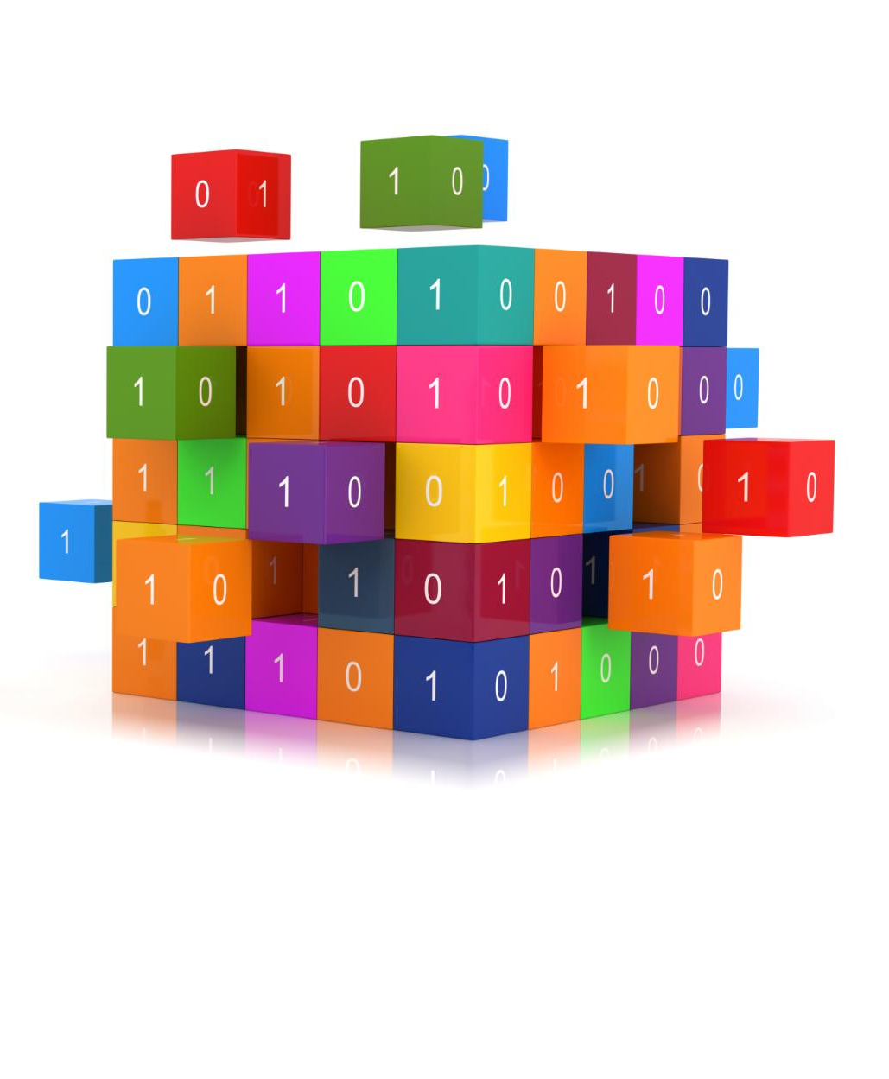
Feature Engineering: Removing High-Cardinality and Irrelevant Columns, Applying One-Hot Encoding
Importance of Feature Engineering
Feature engineering is crucial for enhancing the performance of machine learning models by refining input data.
Removing High-Cardinality Columns
Removable high-cardinality features can lead to overfitting; hence, identifying and removing them is essential.
Applying One-Hot Encoding
One-hot encoding transforms categorical variables into a format suitable for machine learning algorithms, improving model accuracy.
Notes:
Feature engineering is vital for improving model performance. This includes removing high-cardinality columns, irrelevant features, and applying one-hot encoding to categorical variables.

Slide 11

Model Building: Logistic Regression, Random Forest, and SVM with Hyperparameter Tuning
Logistic Regression
Logistic Regression is a statistical method for predicting binary outcomes. Its simplicity and efficiency make it a popular choice for many applications.
Random Forest
Random Forest is an ensemble learning method that operates by constructing multiple decision trees for improved accuracy and robustness.
Support Vector Machine (SVM)
SVM is a powerful classification technique that finds the optimal hyperplane to separate different classes in a dataset.
Hyperparameter Tuning
Hyperparameter tuning is essential to optimize the performance of machine learning models, enhancing their predictive capabilities.
Notes:
We built several models, including Logistic Regression, Random Forest, and Support Vector Machine (SVM). Hyperparameter tuning was applied to optimize their performance.

Slide 12
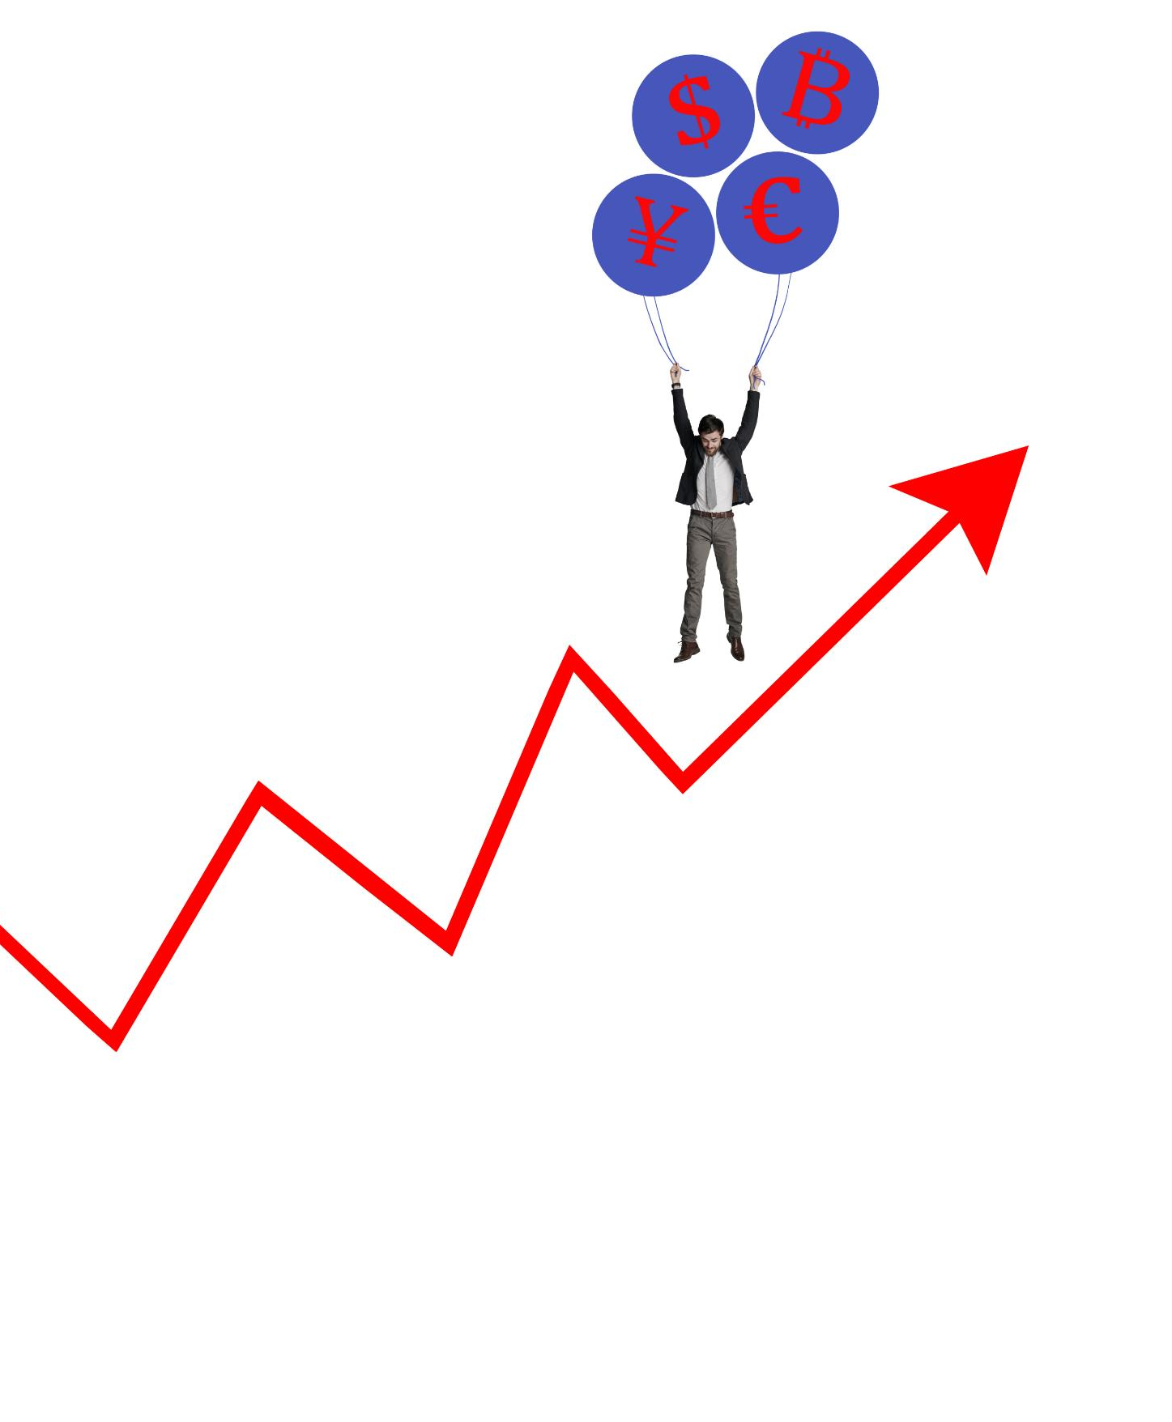
Evaluation: Accuracy, Precision, and Recall Metrics
Understanding Accuracy
Accuracy measures the overall correctness of a predictive model, representing the ratio of correctly predicted instances to total instances.
Precision Explained
Precision indicates the proportion of true positive predictions among all positive predictions made by the model, reflecting the quality of positive predictions.
Recall Importance
Recall measures the ability of the model to identify all relevant instances, indicating the proportion of true positives among actual positives.
Notes:
Model evaluation focuses on accuracy, precision, and recall metrics to assess the performance of our predictive models and ensure reliable outcomes.

Slide 13
Results in Business Terms
Notes:
The results of our analysis translate directly into actionable business insights. We will discuss the key findings and recommendations for sales prioritization.

Slide 14
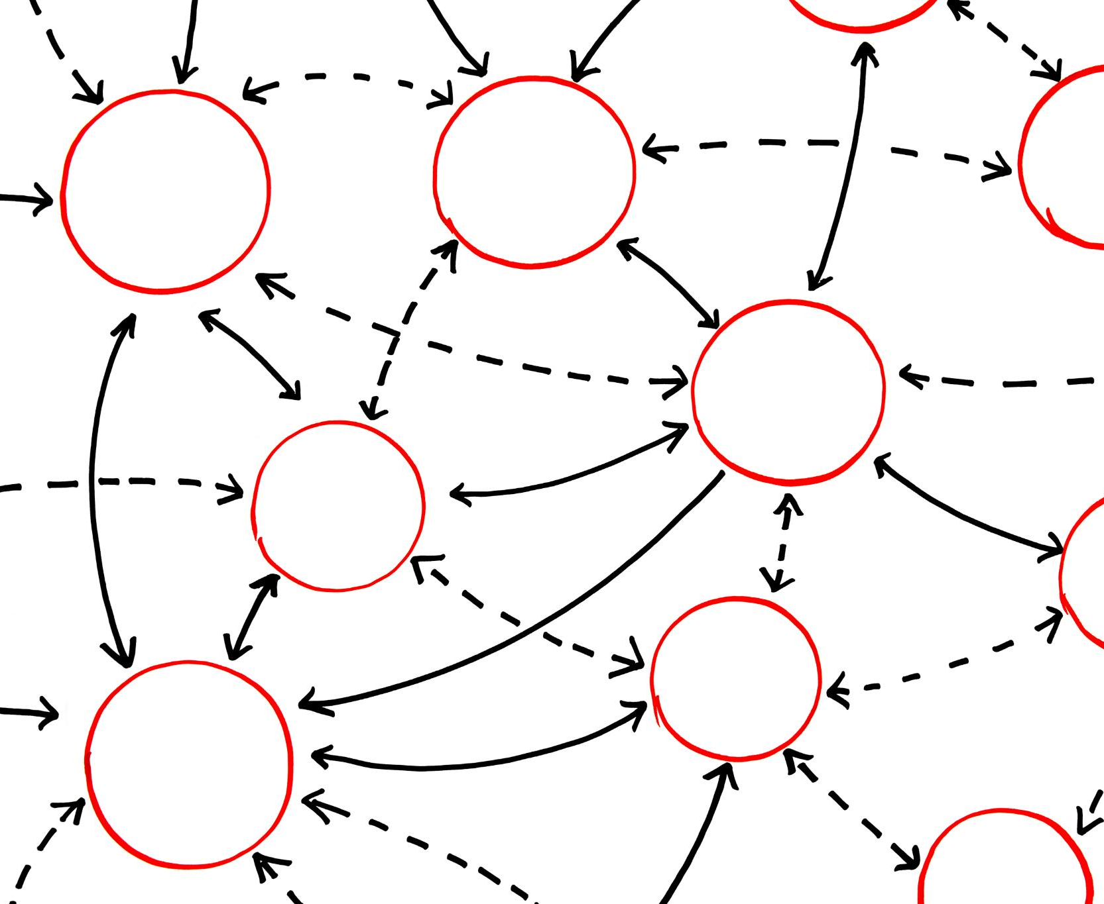
Insights: Key Features Identified by Random Forest
Lead Conversion Factors
The Random Forest model identified crucial factors that significantly influence lead conversion rates, providing actionable insights for improvement.
Focus on Essentials
By identifying key features, we can prioritize our strategies and resources on what is most impactful for lead conversions.
Notes:
The Random Forest model highlighted key features that contribute significantly to lead conversion, allowing us to focus on what matters most.

Slide 15
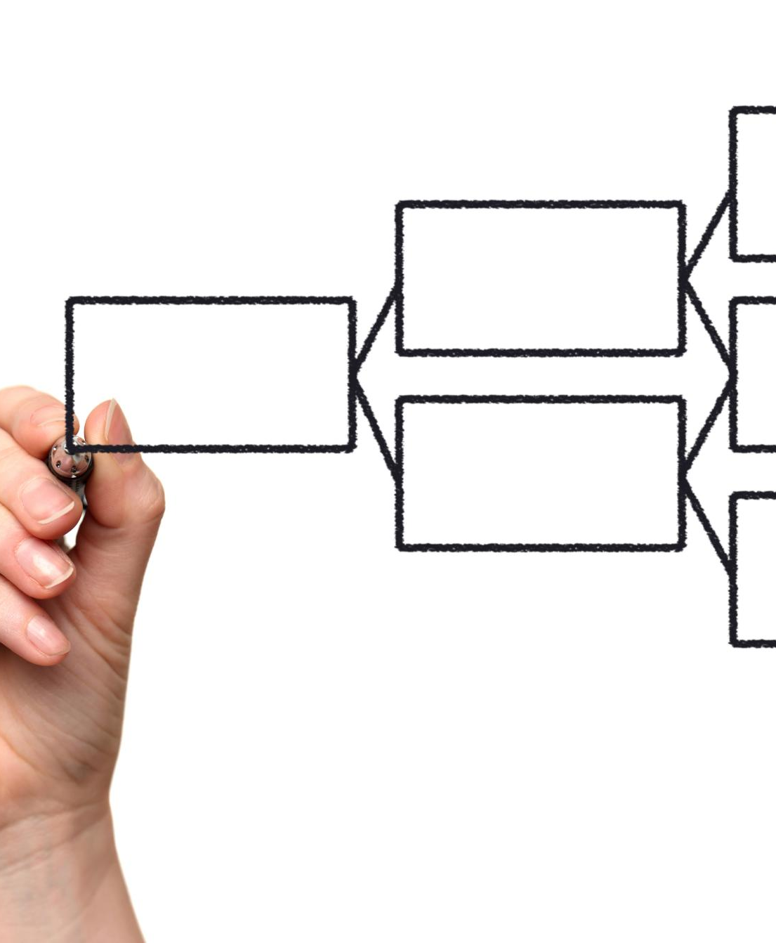
Lead Scoring: Prioritization with Logistic Regression and SVM
Lead Scoring System
A lead scoring system helps sales teams identify high-priority leads based on their likelihood to convert.
Logistic Regression
Logistic Regression is used to predict the probability of a lead converting, providing a statistical basis for scoring.
Support Vector Machine (SVM)
SVM enhances the lead scoring process by effectively separating leads into different categories for better prioritization.
Notes:
Using Logistic Regression and SVM, we developed a lead scoring system that allows sales teams to prioritize their efforts based on conversion likelihood.

Slide 16

Recommendations: Focus on High-Probability Leads, Reduce Efforts on Low-Probability Leads
High-Probability Leads
Focusing on high-probability leads ensures efficient follow-ups and maximizes conversion rates, leading to better outcomes.
Reducing Low-Probability Efforts
Minimizing efforts on low-probability leads frees up valuable resources for high-impact opportunities, optimizing overall performance.
Optimizing Resource Allocation
Effective resource allocation is essential to enhance productivity and ensure a focus on the most promising leads.
Notes:
Our recommendations include concentrating on high-probability leads for follow-ups while reducing efforts on leads with a low likelihood of conversion, optimizing resource allocation.

Slide 17
Visualizations
Notes:
Visualizations play a crucial role in communicating our findings. We will present visual data representations that provide insights into lead conversion.

Slide 18

Lead Conversion Funnel: Bar Plot of Conversion Rates
Lead Conversion Stages
The lead conversion funnel consists of multiple stages that track the journey of leads from initial contact to final conversion.
Conversion Rate Analysis
Analyzing conversion rates at each stage helps us understand effectiveness and identify areas needing improvement.
Identifying Bottlenecks
Identifying potential bottlenecks in the funnel is crucial for optimizing the lead conversion process and increasing sales.
Notes:
The lead conversion funnel visualization provides a clear bar plot of conversion rates at different stages, helping us identify potential bottlenecks.

Slide 19

Feature Importance: Key Variables Impacting Lead Conversion
Understanding Feature Importance
Feature importance helps identify which variables most significantly influence lead conversion rates, informing effective sales strategies.
Guiding Sales Strategies
Identifying key variables allows teams to prioritize efforts on the most impactful areas for improving conversions.
Notes:
A feature importance chart illustrates which variables have the most significant impact on lead conversion, guiding our future sales strategies.

Slide 20
Summary of Results
Notes:
In conclusion, we will summarize the key results of our analysis, focusing on actionable insights derived from our machine learning models.

Slide 21

Top Features Driving Conversion Identified by Random Forest
Effective Feature Identification
The Random Forest model is renowned for its ability to accurately identify key features influencing conversion rates.
Sales Strategy Optimization
Understanding the identified features allows for better targeting of sales strategies and improving conversion rates.
Notes:
The Random Forest model effectively identified the top features driving conversion, which is essential for targeting our sales strategies.

Slide 22

Important Dummy Features: 'Lead Source_Email' And 'Last Activity_SMS'
Lead Source: Email
The 'Lead Source_Email' feature is crucial in determining how leads originate and their potential for conversion.
Last Activity: SMS
The 'Last Activity_SMS' feature highlights the impact of recent SMS interactions on lead conversion rates.
Notes:
Two critical dummy features identified include 'Lead Source_Email' and 'Last Activity_SMS', indicating significant factors influencing conversion likelihood.

Slide 23

Follow-Up Strategies: Aggressive Follow-Ups with High-Probability Leads, Reduced Effort on Low-Probability Leads
Aggressive Follow-Ups
Implement aggressive follow-up strategies to engage high-probability leads effectively and increase conversion rates.
Measured Approach
Adopt a more measured and strategic approach for low-probability leads to optimize resource allocation and effort.
Notes:
We recommend aggressive follow-up strategies for high-probability leads, while adopting a more measured approach for low-probability leads to enhance efficiency.

Slide 24
Conclusion
Insights from Machine Learning
Our analysis revealed valuable insights into lead conversion, highlighting the power of machine learning in sales strategies.
Prioritizing High-Probability Leads
By focusing on high-probability leads, businesses can enhance their chances of successful conversions and maximize sales.
Data-Driven Strategies
Implementing data-driven strategies allows businesses to refine their approaches and improve overall sales outcomes.
Notes:
In summary, our analysis using machine learning has provided valuable insights into lead conversion. By prioritizing high-probability leads and implementing data-driven strategies, businesses can improve their sales outcomes.

